Slide 1
Metric Formulation

Slide 2
Topics
Recent Changes to the Simulation
Metric Formulation
Service Provision Index
Cost Index
Results
Infrastructure Index (not implemented yet)
Further Thoughts

Slide 3
Recent Changes to the Simulation
Changed priority weights to 1/threshold (as per the threshold times for Immediate, Prompt, Standard and Other Resolution)
Updated the estates to include the police stations from L division

Slide 4
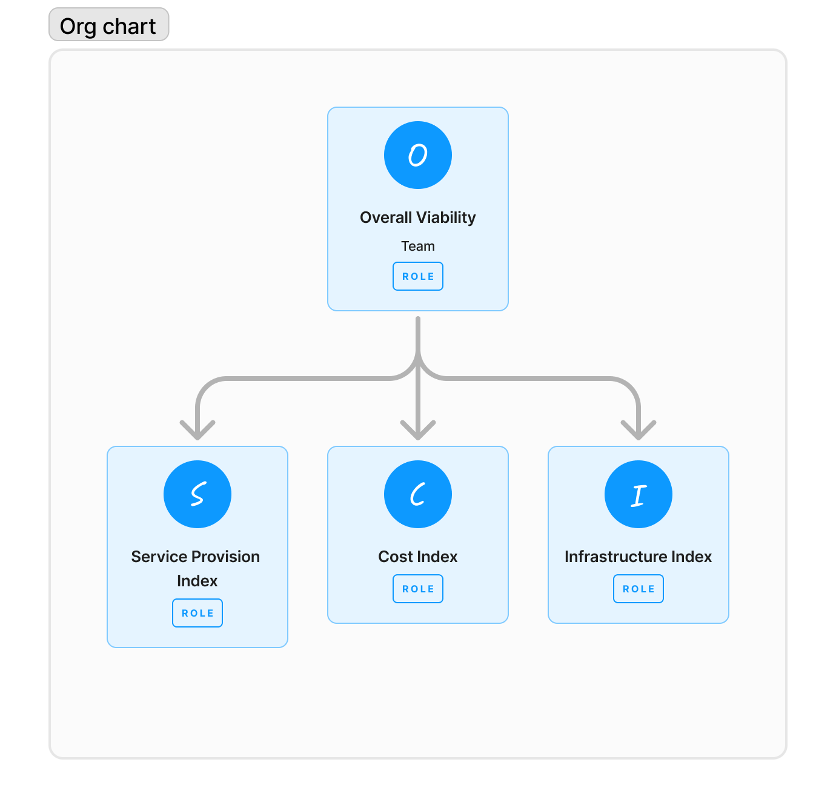
2. Metric
Overall Viability
Service Provision Index
Protection Coverage
Resolution of Incidents
Resolution of Incidents on Time
Cost Index
Running Costs per unit area and head (officer)
Infrastructure (Not implemented)
Co-location index
Condition Grade
Amenities
Forensic / Firearms
EV
etc.

Slide 5
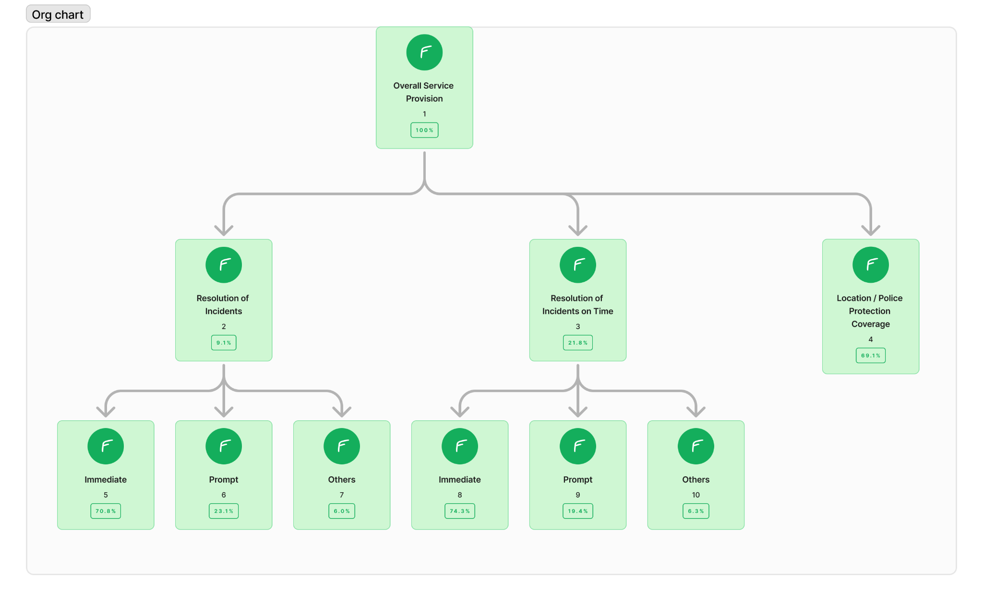
3. Service Provision Index
Overall Service Provision
Protection Coverage
Resolution of Incidents
Immediate
Promp
Others
Resolution of Incidents on Time
Immediate
Prompt
Others

Slide 6
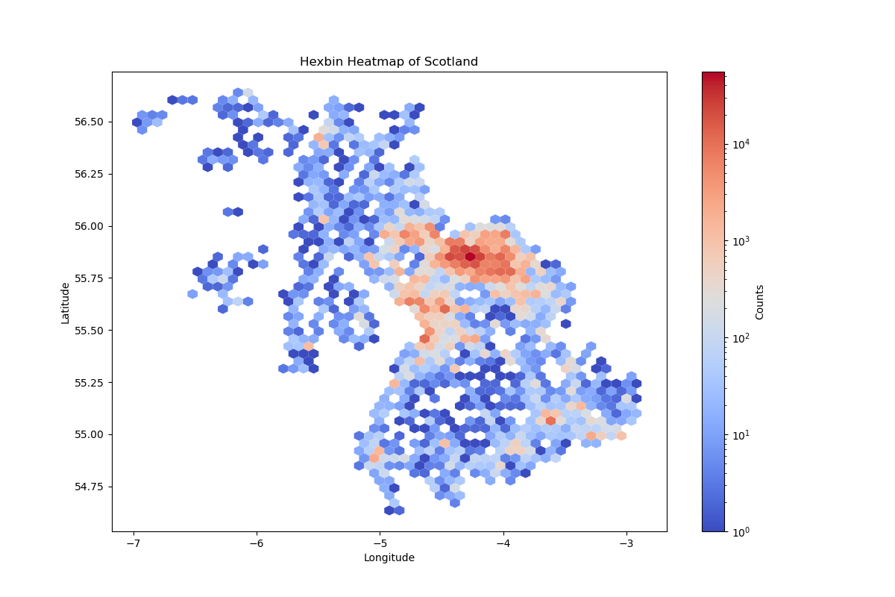
3.1 Geographical Spread of Demand
There are some prominent hotspots across the landscape.
Glasgow
West of Glasgow
South

Slide 7
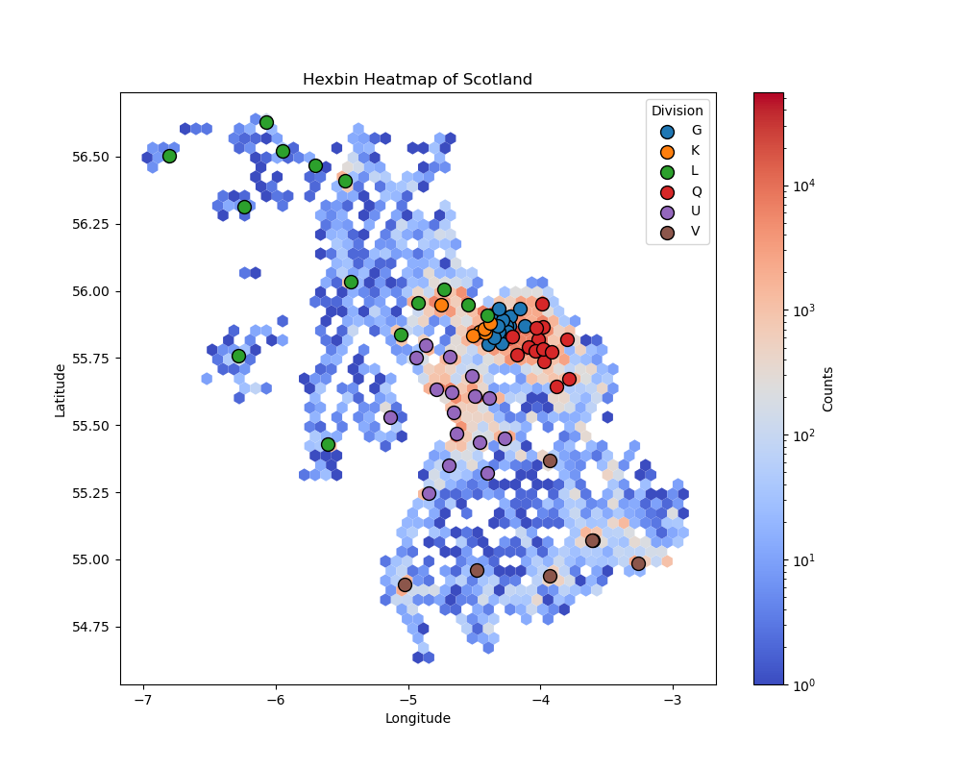
3.2 Police Stations Spread
Density of Police Stations is generally near hotspots.
Hence, the demand is generally well met. Will display the results in the next slide.

Slide 8
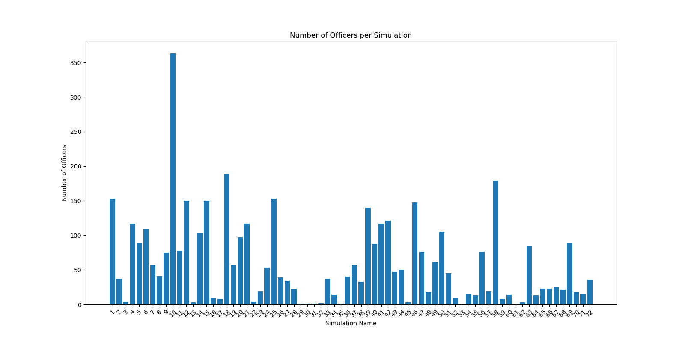
3.2.1 Police Station (Number of Officers)

Slide 9
3.2.1 Police Station (Number of Officers)

Slide 10
3.3 Results of Simulation
'Threshold Compliance': {'Immediate': 87.02463781929089,
'Prompt': 99.10873227321059,
'Standard': 99.06405300938708,
'Other resolution': 99.15740856322557},
'Mean Officer Hours': 467.09059138811955,
'Unresolved Incident Percentage': 0.5822284387386247}
'Mean Response Times': {'Immediate': 0.048508033203144285,
'Prompt': 0.04695388322159069,
'Standard': 0.0476780364171376,
'Other resolution': 0.04942747898508375},
'}
{'Completion Percentages': {'Immediate': 99.03617041555471,
'Prompt': 99.15492845565366,
'Standard': 99.06405300938708,
'Other resolution': 99.15740856322557},
}

Slide 11
3.4 Protection Coverage
Identify incident hotspots across the landscape using clustering.
Use proximity of station location to the hotspot and the probability of incidents occurring near the hotspot to estimate the degree of protection provided by the police station.
Inspiration from source: Dey, A., Heger, A. & England, D. Urban fire station location planning using predicted demand and service quality index. Int J Data Sci Anal 15, 33–48 (2023). https://doi.org/10.1007/s41060-022-00328-x

Slide 12
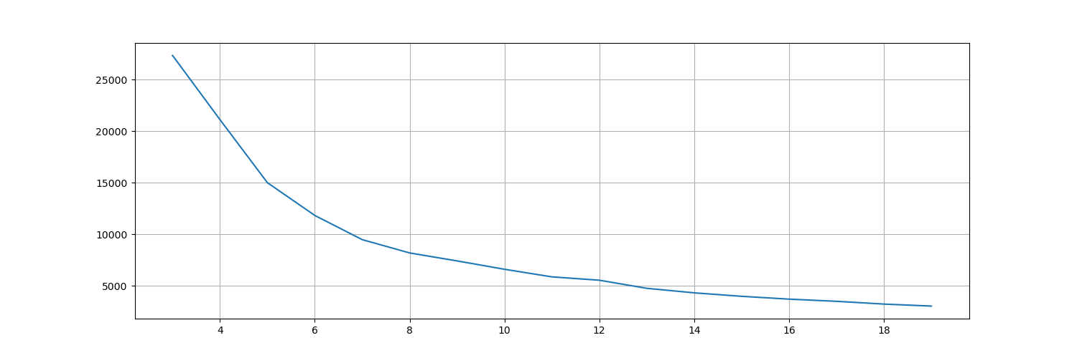
3.4.1 Hotspots of Incidents
Chose n_clusters = 7.
Covers about 70% of mean distance score (inertia). Could choose a higher number if more coverage is required.

Slide 13
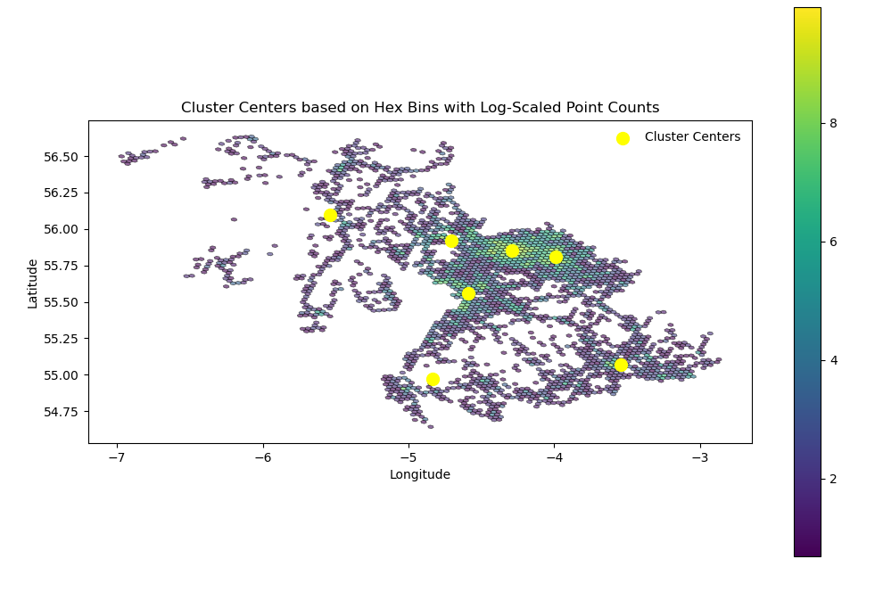
3.4.2 Cluster Centers

Slide 14
3.4.3 Protection Index
Using the demand hotspots, or cluster centroids, the probability of incidents popping up in that cluster is calculated.
Each combination of demand hotspot and police station location is assigned an index (normalised) -
protection_index(i, j) = Prob. of Incident popping up (i) * distance (j)
(i - cluster center), (j - police station)
Prob. between [0, 1]
For each station, chosen minimum of all protection_index(i, j) for j = police station to get the station’s best coverage value

Slide 15
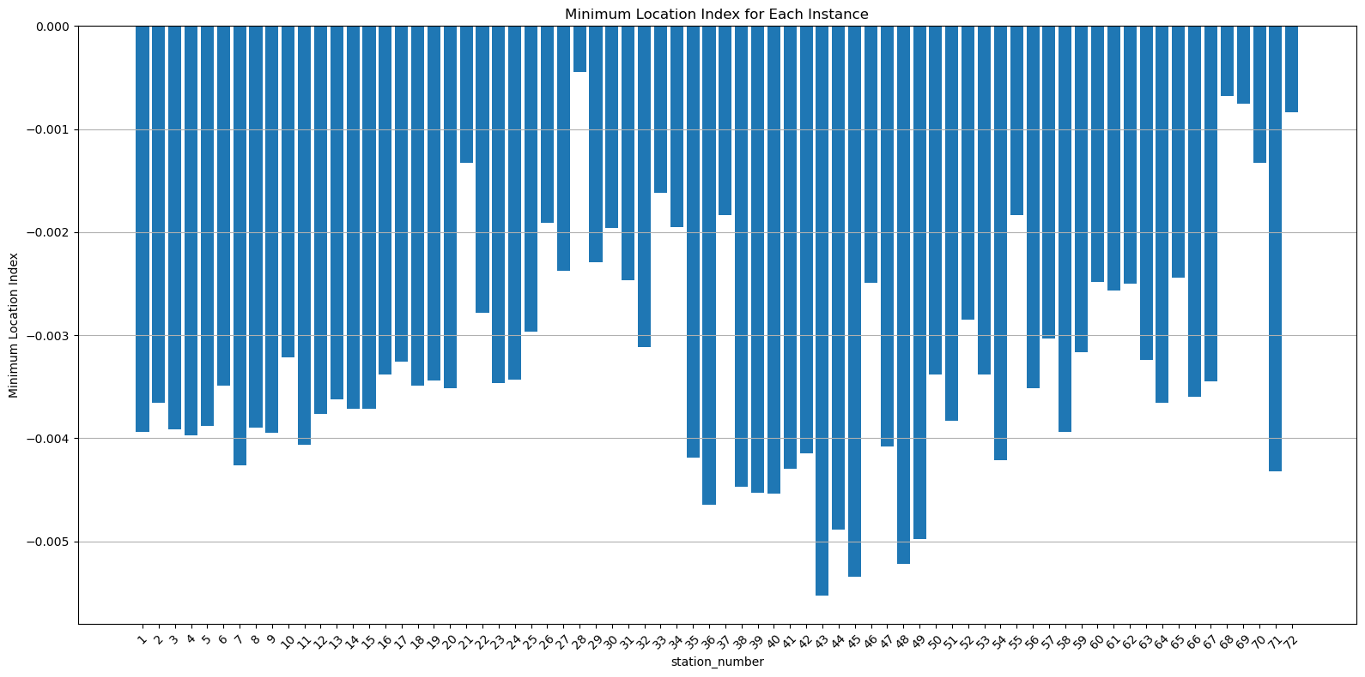
3.4.3 Continued
The lower the value the better. Hence, it is normalised while keeping this in mind.

Slide 16
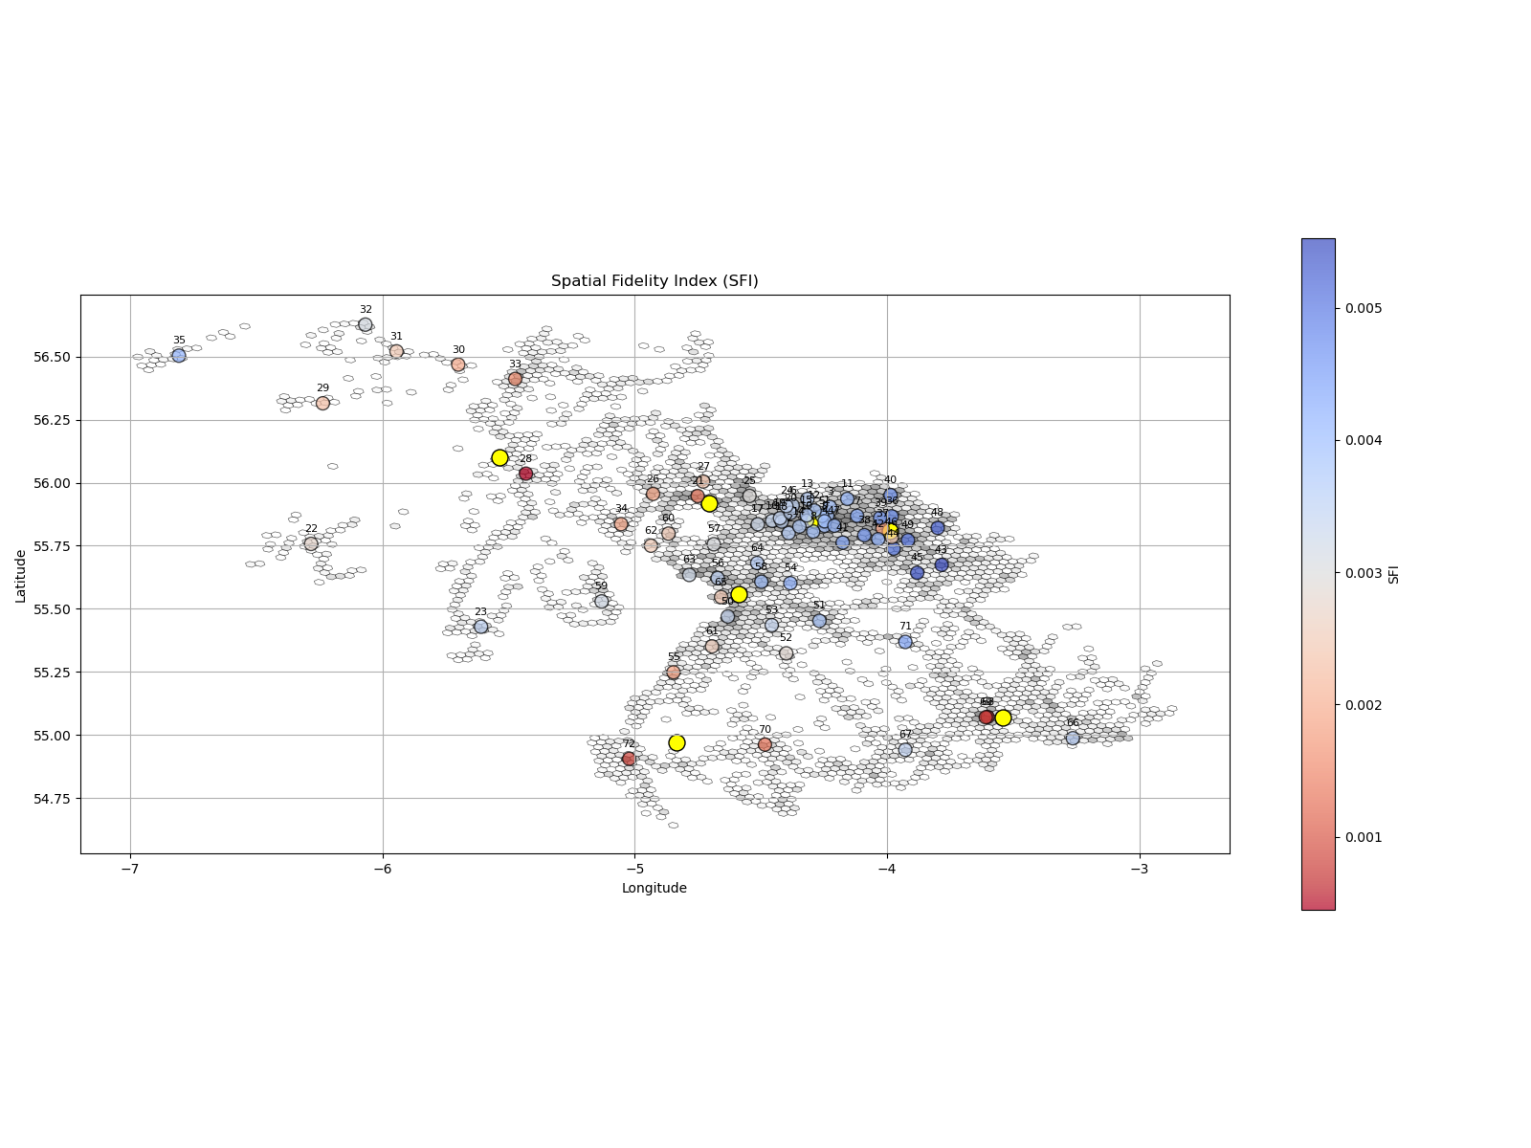
3.4.3 Protection Index
Warm is better (negative scale)

Slide 17
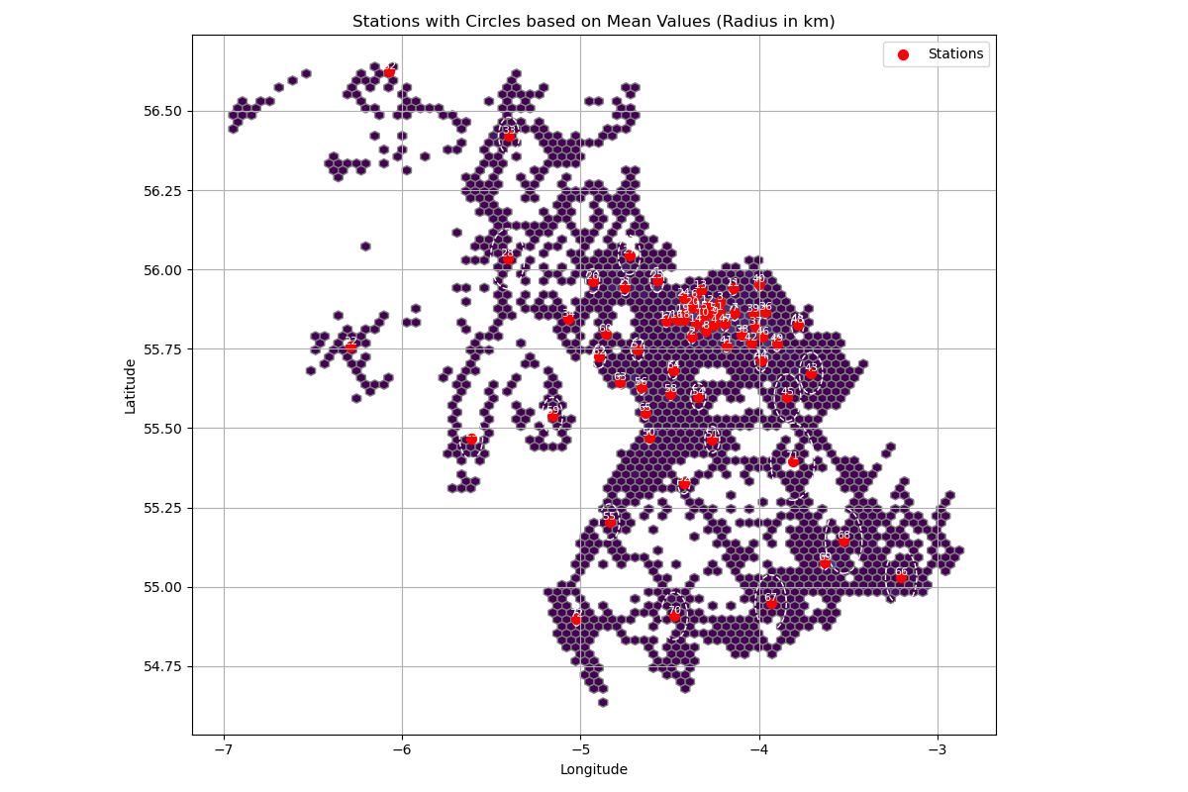
3.4.4 Alternates - Catchment Area
Radius is calculated using the mean travel time for incident resolution

Slide 18
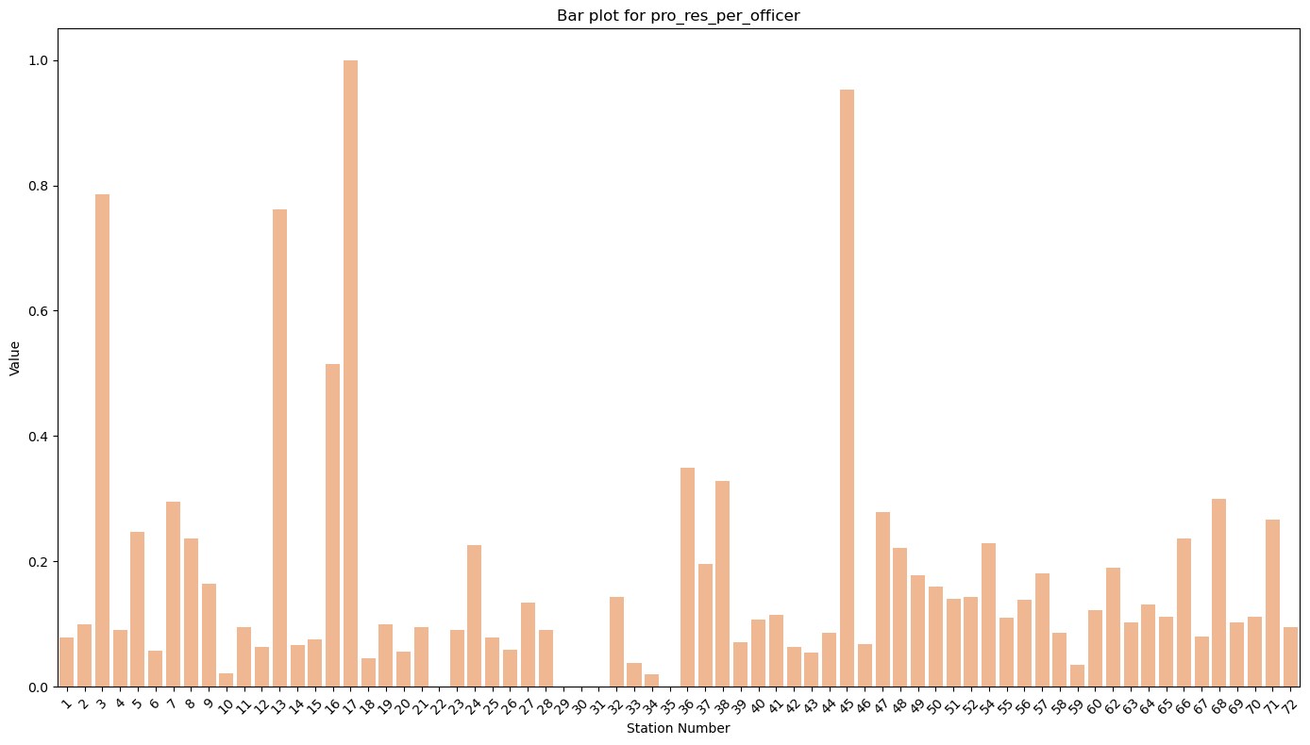
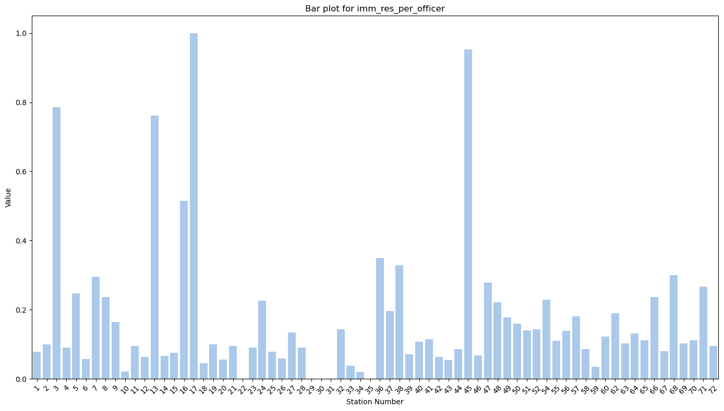
3.5 Resolution of Incidents
Number of incidents resolved per officer

Slide 19
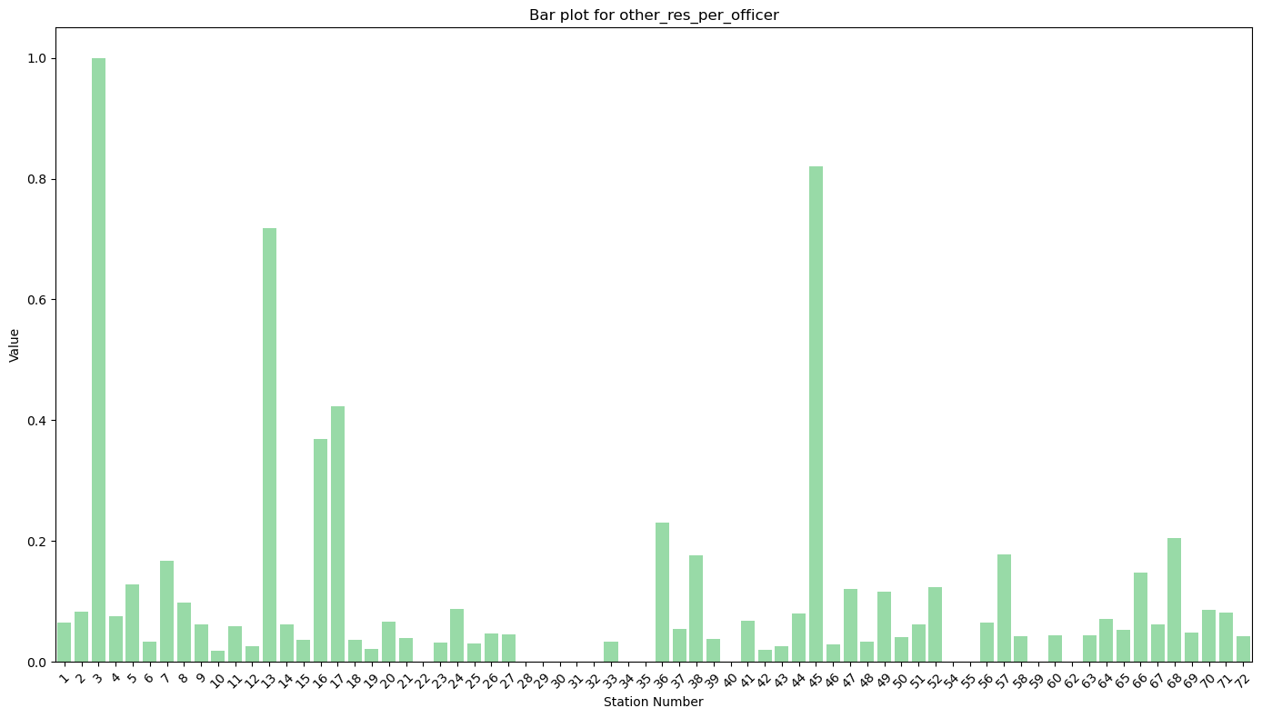
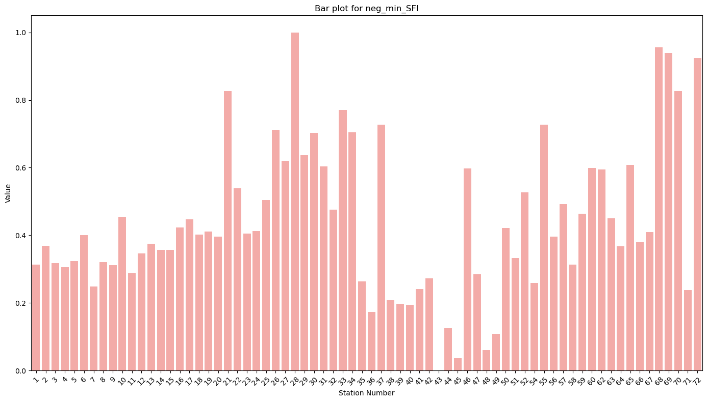
3.5.1 Contd.

Slide 20
3.6 Resolution of Incidents on Time
Percentages considered here.
Immediate
Prompt
Others

Slide 21
3.7 Combining Service Factors
Analytic Hierarchy Process
Source: R.W. Saaty, The analytic hierarchy process—what it is and how it is used, Mathematical Modelling, Volume 9, Issues 3–5, 1987, Pages 161-176, ISSN 0270-0255, https://doi.org/10.1016/0270-0255(87)90473-8.

Slide 22
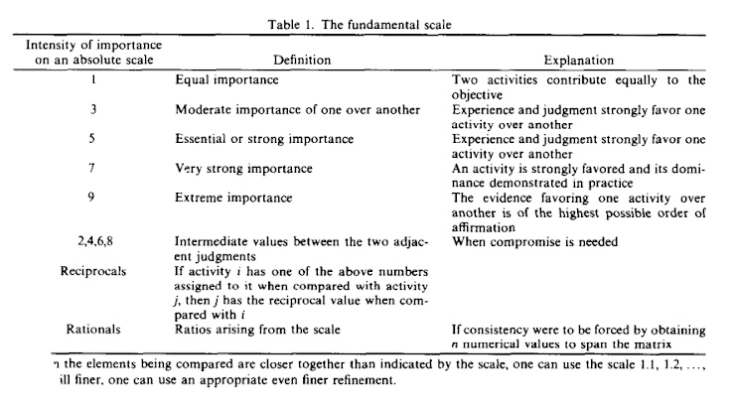
3.7.1 Scale

Slide 23
3.8 Hierarchy for Service
OVERALL SERVICE PROVISION
Location / Protection Coverage
Resolution of Incidents (Counts)
Immediate Resolution
Prompt Resolution
Others
Resolution of Incident on Time (Percentages)
Immediate Resolution
Prompt Resolution
Others

Slide 24
3.8.1 Matrices
First Level
 | Protection Coverage | Resolution of Incidents on Time | Resolution of Incidents
Protectio Coverage | 1 | 4 | 6
Resolution of Incidents on Time | 0.25 | 1 | 3
Resolution of Incidents | 0.17 | 0.33 | 1
Factor | Weight (%)
Protection Coverage | 69.1
Resolution of Incidents on Time | 21.8
Resolution of Incidents | 9.1

Slide 25
3.8.2 Matrices
Second Level
 | Immediate | Prompt | Others
Immediate | 1 | 4 | 9
Prompt | 0.25 | 1 | 5
Others | 0.11 | 0.2 | 1
Factor | Weight (%)
Immediate | 70.8
Prompt | 23.1
Others | 6.0

Slide 26
3.8.2 Matrices
 | Immediate | Prompt | Others
Immediate | 1 | 5 | 9
Prompt | 0.20 | 1 | 4
Others | 0.11 | 0.25 | 1
Factor | Weight (%)
Immediate | 74.3
Prompt | 19.4
Others | 6.3

Slide 27
3.9 Final Hierarchy
* Location / Police Protection Coverage (69.1%)
* Resolution of Incidents (Count) (9.1%)
* Immediate (70.8%)
* Propmpt (23.1%)
* Other (6.0%)
* Resolution of Incidents on Time (Precentage) (21.8%)
* Immediate (74.3%)
* Prompt (19.4%)
* Other (6.3%)

Slide 28
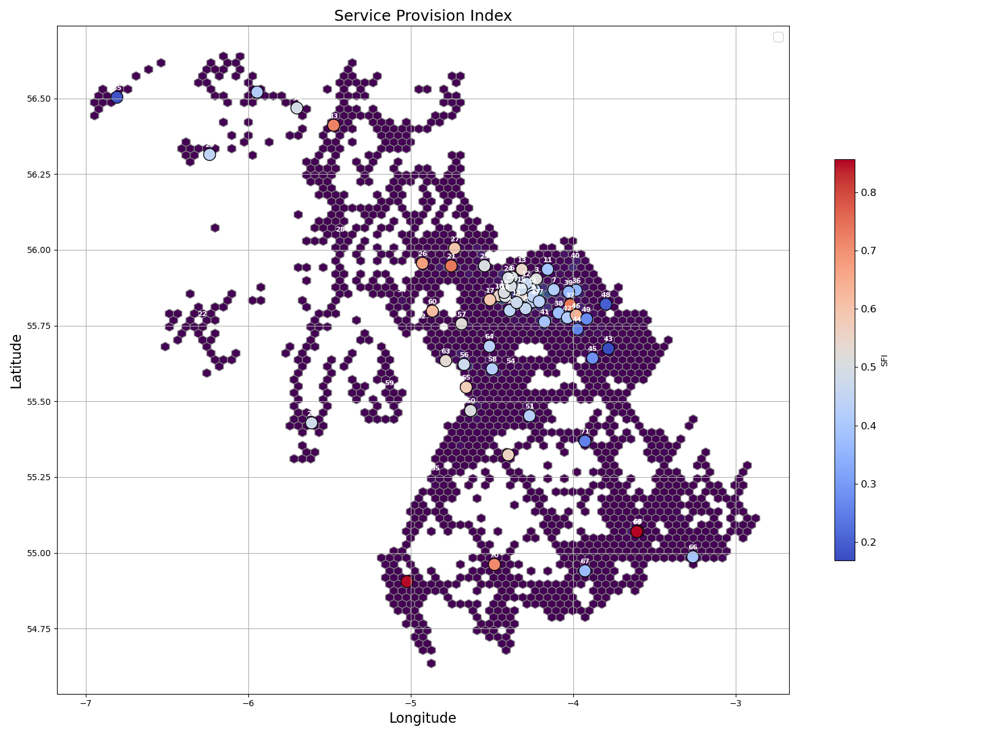
3.10 Service Provision Index

Slide 29
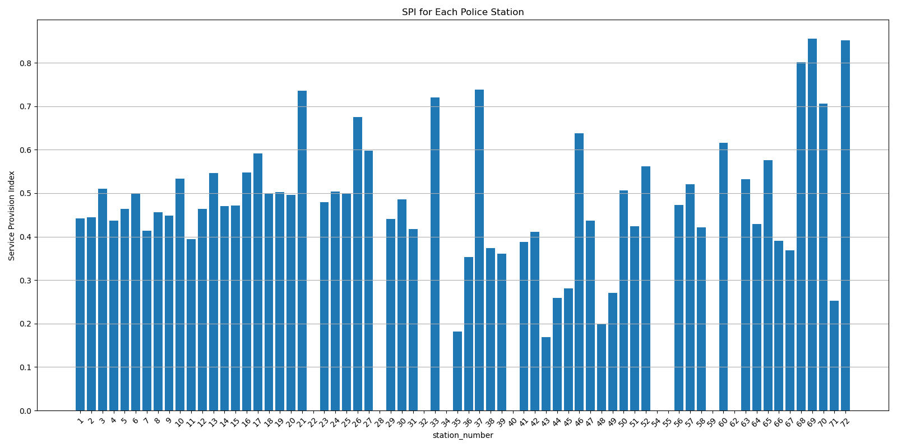
3.11 Service Provision Index

Slide 30
4.1 Costs Hierarchy
Factors
Total Running costs
Headcount
Property area
Metric - Total Running costs / headcount / property area

Slide 31
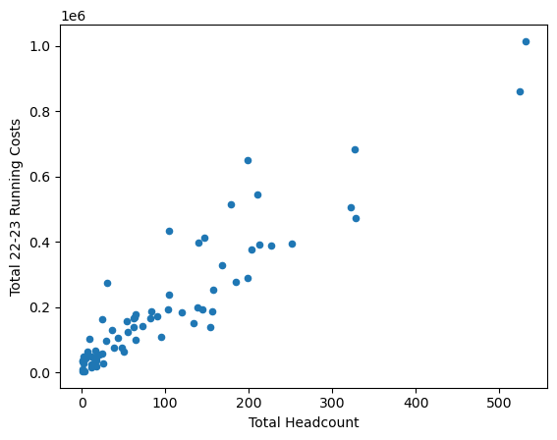
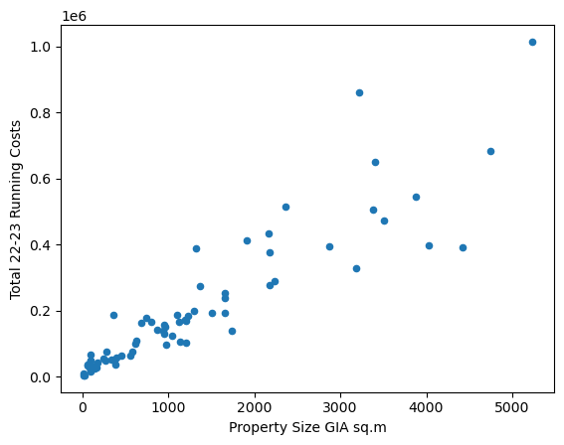
4.2 Problems with this metric

Slide 32
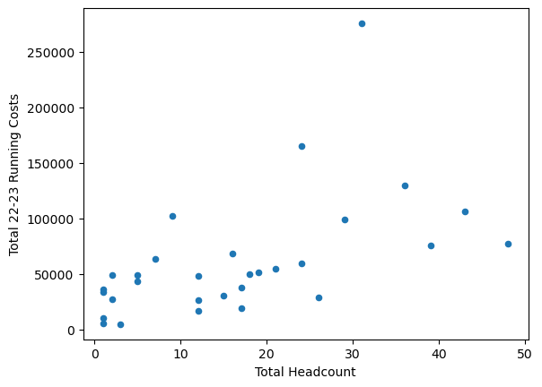
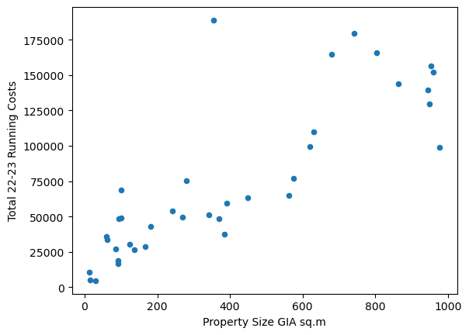
4.2.1 Problems continued

Slide 33
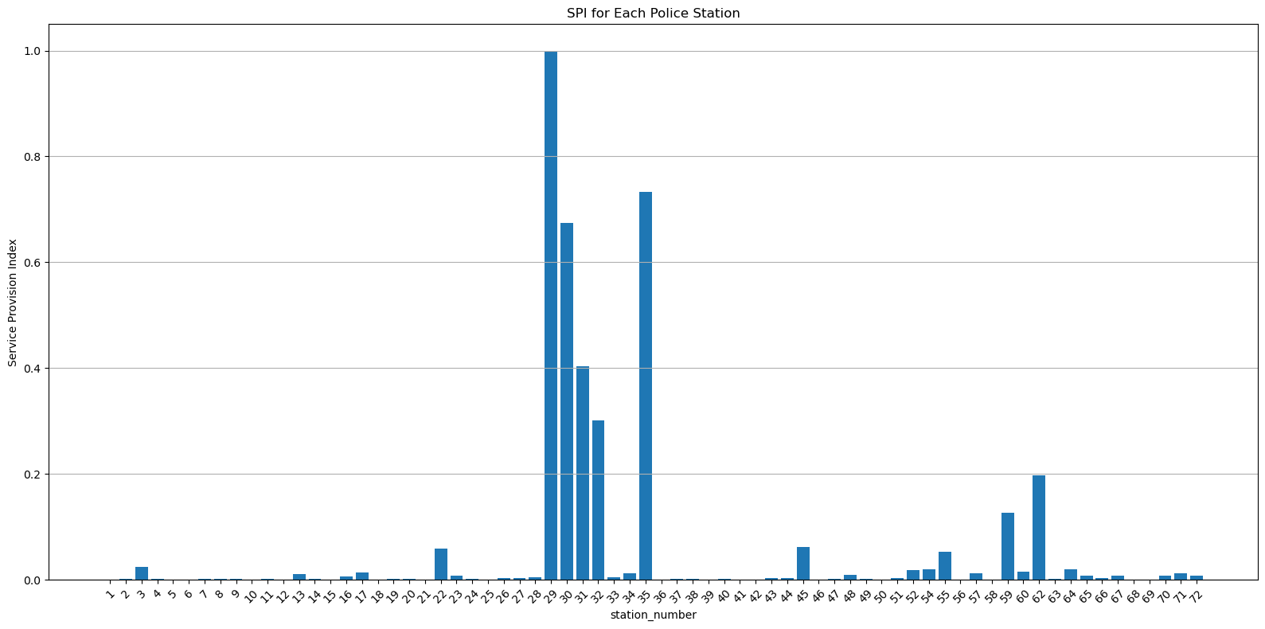
4.2.2 Tackling using Economies of Scale
Assumption: Base Cost + cost per unit area or headcount

Slide 34
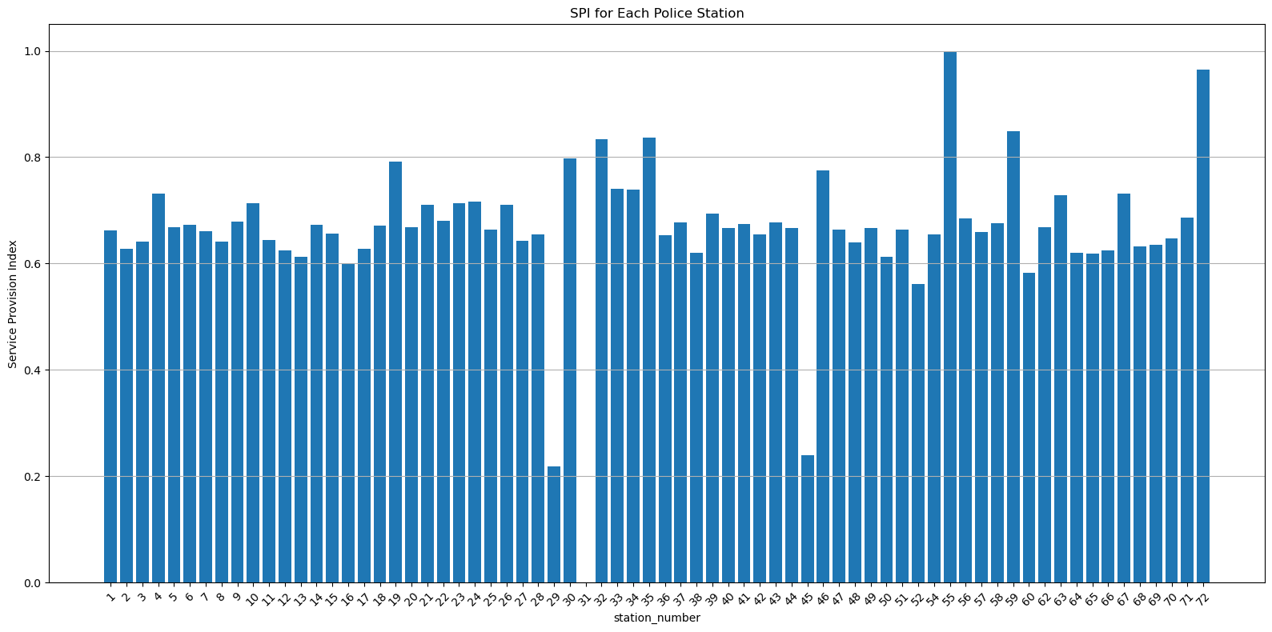
4.3 Costs

Slide 35
4.4 Suggestion to Improve this?
Better modelling of the economics of scale?
No modelling at all?
Perhaps a different approach?

Slide 36
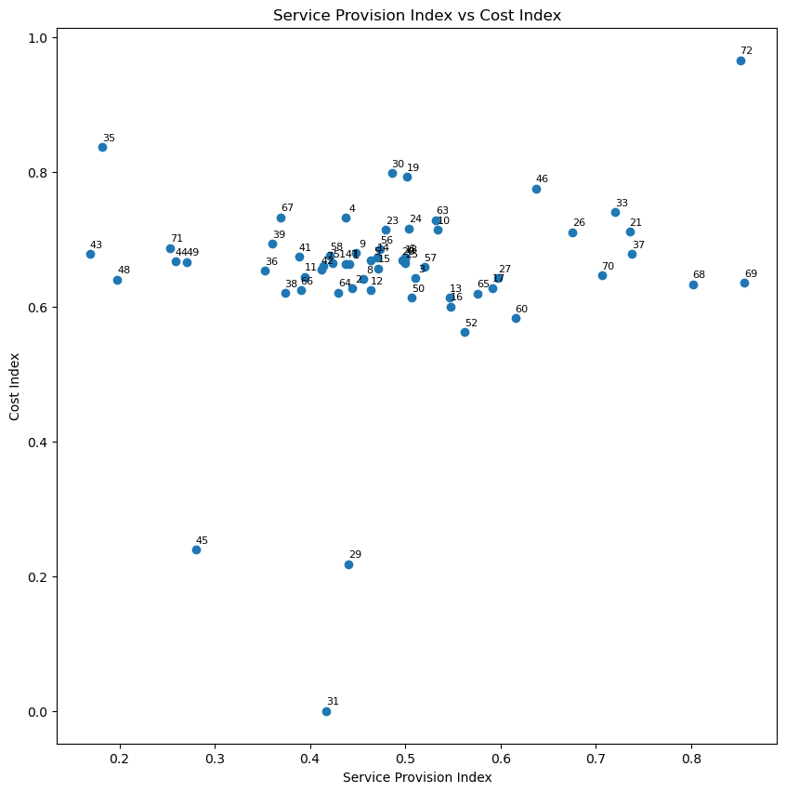
5.1 Results

Slide 37
6.1 Infrastructure Index (Not implemented yet)
Co-location Metric
Condition Grade
Amenities
Forensic Labs
Firearms
Ammunitions Store
Dogs Store
Fleet Workshop
Mortuary
Stores
Accomodation
Number of Parking Spaces
EV

Slide 38
Idea
A paper could be written about this project. I believe this technique is worth sharing and might help others in their pursuits as well.
Perhaps, the four of us could team up to write a paper, if the regulations allows us to do so.

